Slide 1
Routing

Slide 2
Routing
Routing Techniques
Static Versus Dynamic Routing
Routing Table for Classful Addressing
Routing Table for Classless Addressing

Slide 3
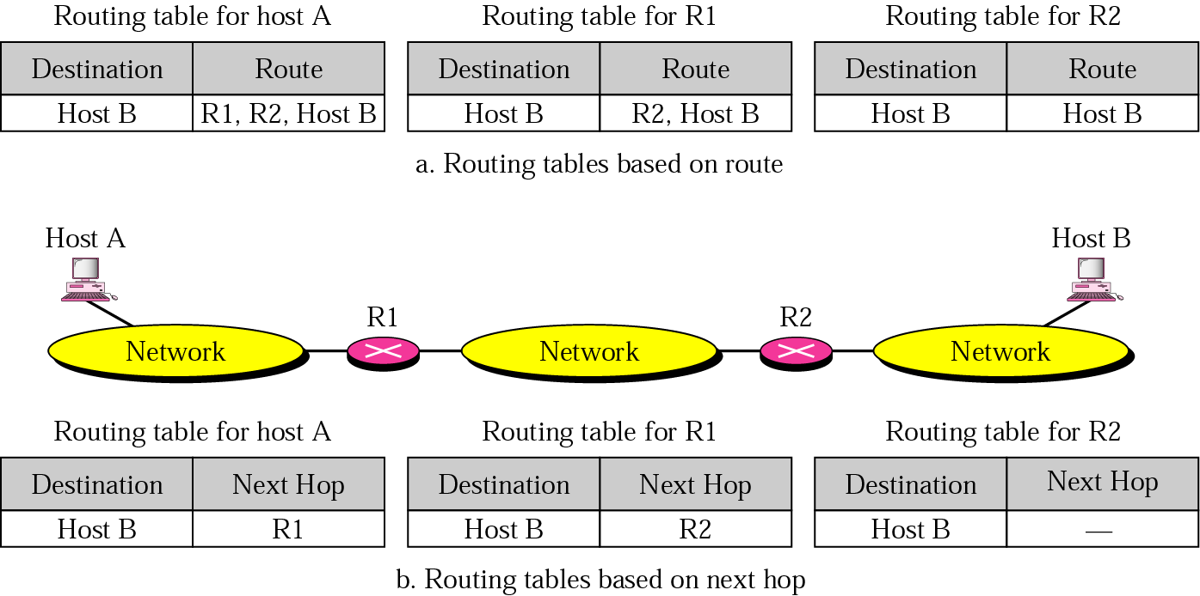
Next-hop routing

Slide 4
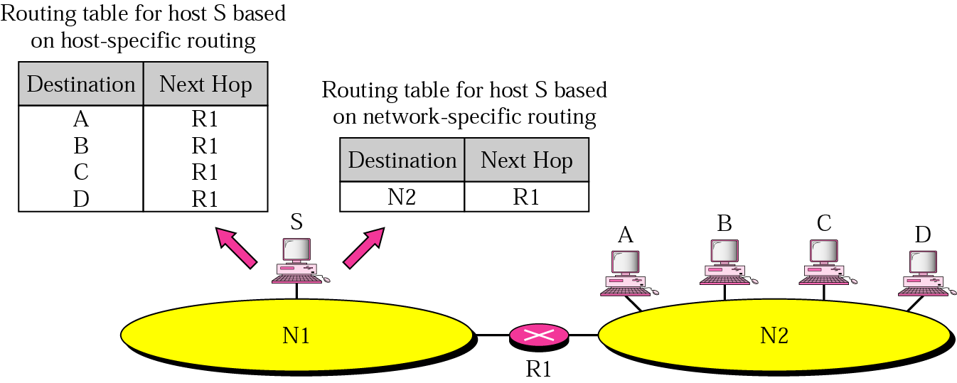
Network-specific routing

Slide 5
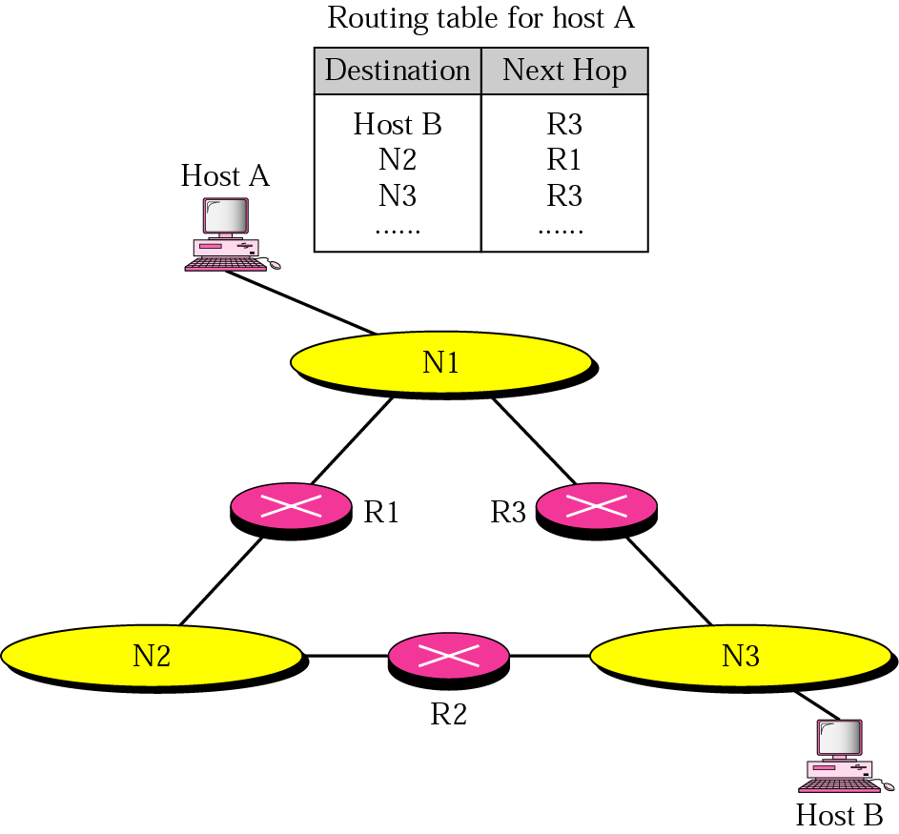
Host-specific routing

Slide 6
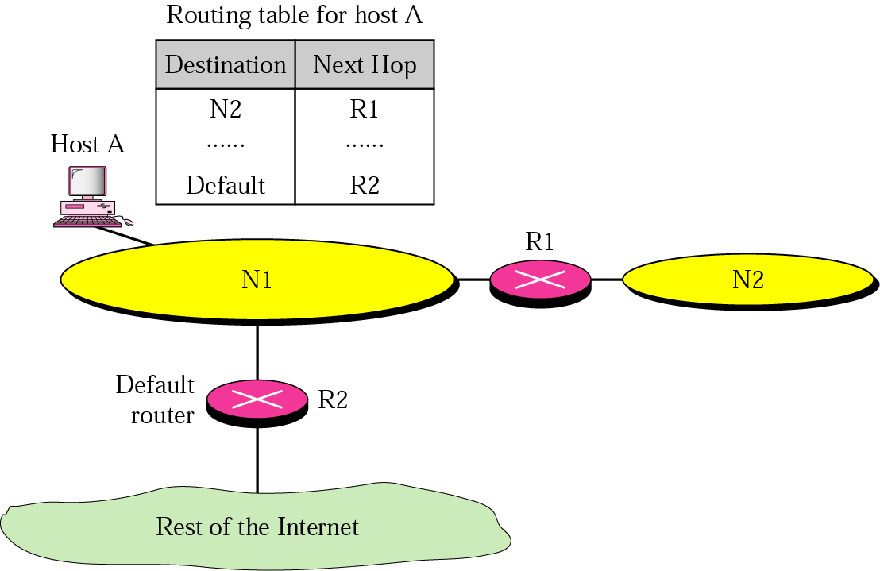
Figure 19.31 Default routing

Slide 7
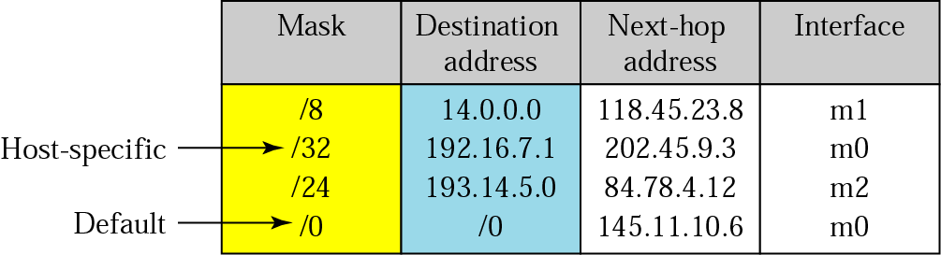
Figure 19.32 Classful addressing routing table

Slide 8
Routing Protocols

Slide 9
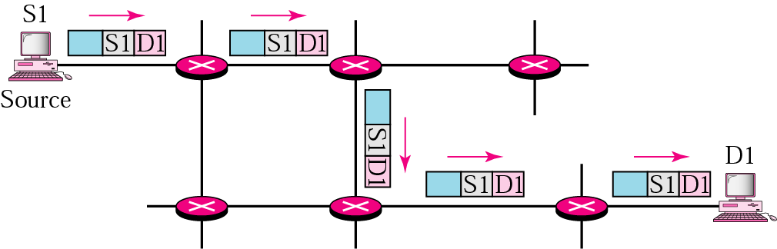
Unicasting

Slide 10

Note:
In unicast routing, the router forwards the received packet through only one of its ports.

Slide 11
Distance Vector Routing
Each router periodically shares its knowledge about the entire internet with its neighbours
  Sharing the knowledge about the entire autonomous system
  Sharing only with neighbours
  Sharing at regular intervals

Slide 12
Routing Table
Every router keeps a routing table that has one entry for each destination network of which the router is aware
Destination | Hop Count | Next Router | Other information
163.5.0.0 | 7 | 172.6.23.4
197.5.13.0 | 5 | 176.3.6.17
189.45.0.0 | 4 | 200.5.1.6
115.0.0.0 | 6 | 131.4.7.19

Slide 13
Link State Routing
Process by which each router shares its knowledge about its neighbourhood with every router in the area
  Sharing knowledge about the neighbourhood
  Sharing with every other router – flooding
  Sharing when there is a change – results in lower internet traffic than that required by distance vector routing

Slide 14
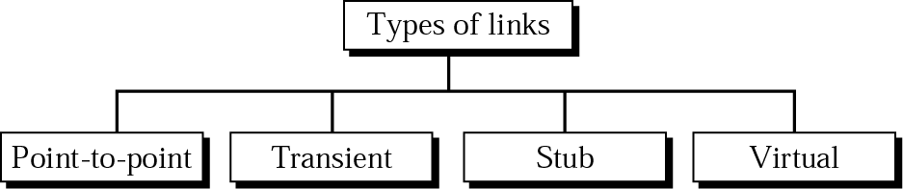
Types of links

Slide 15
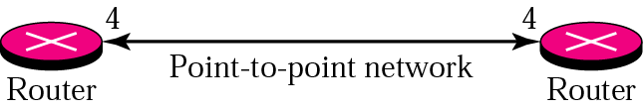
Point-to-point link

Slide 16
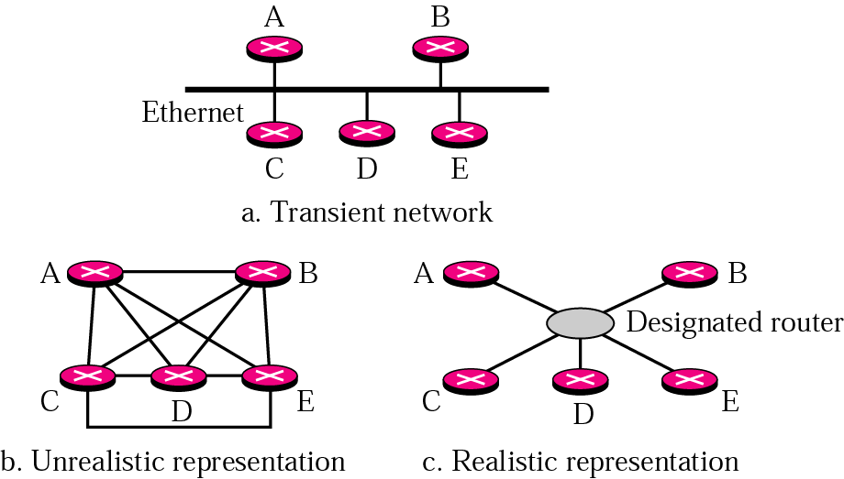
Transient link

Slide 17
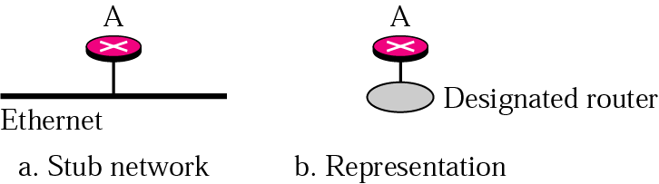
Stub link

Slide 18
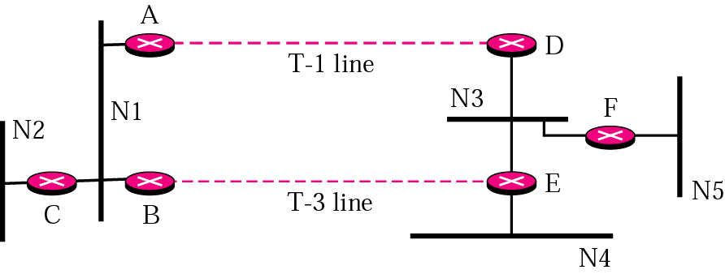
Example of an internet

Slide 19
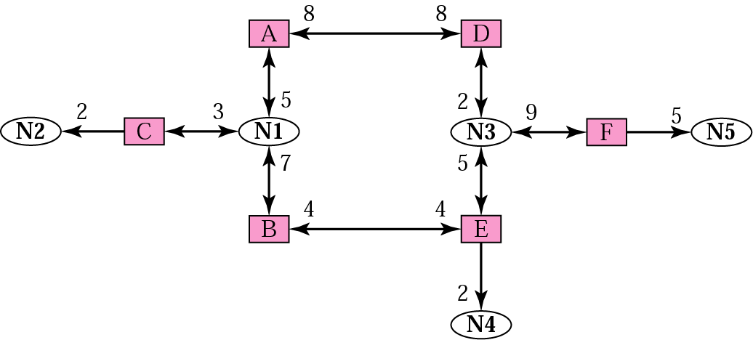
Graphical representation of an internet

Slide 20
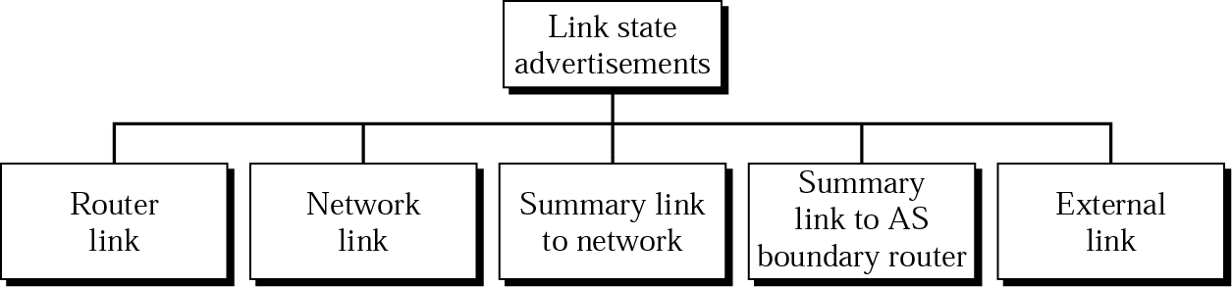
Types of LSAs
Link State Advertisements :
To share information about their neighbour each entity distributes link state advertisements (LSAs)
LSA announces the states of entity links

Slide 21
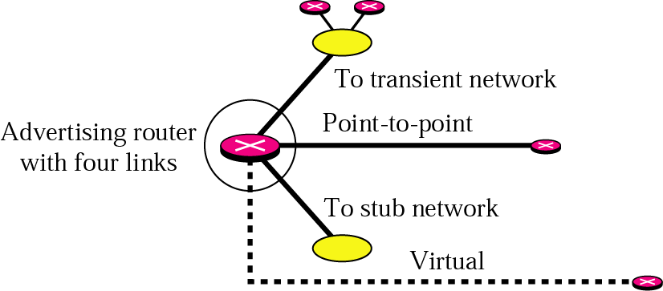
Router link

Slide 22
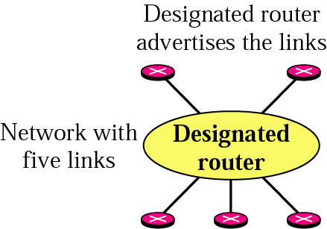
Network link

Slide 23
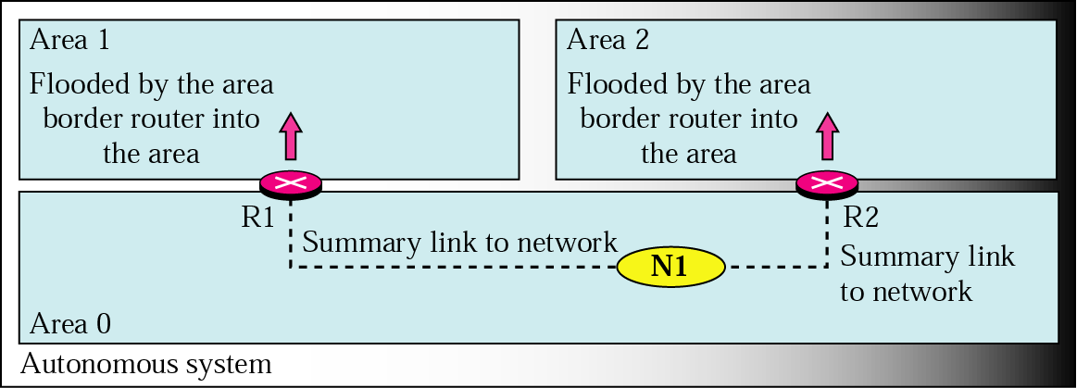
Summary link to network

Slide 24
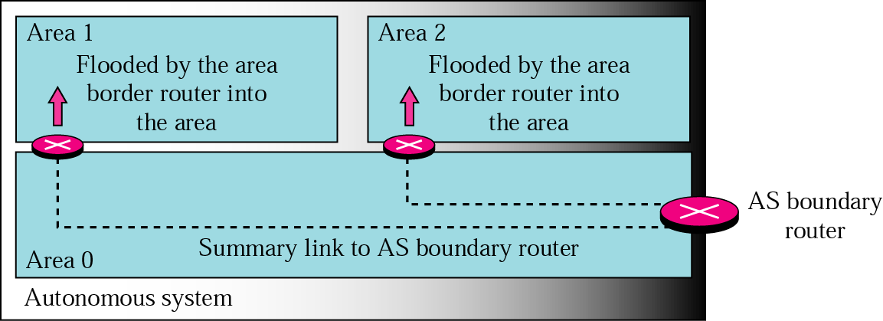
Summary link to AS boundary router

Slide 25
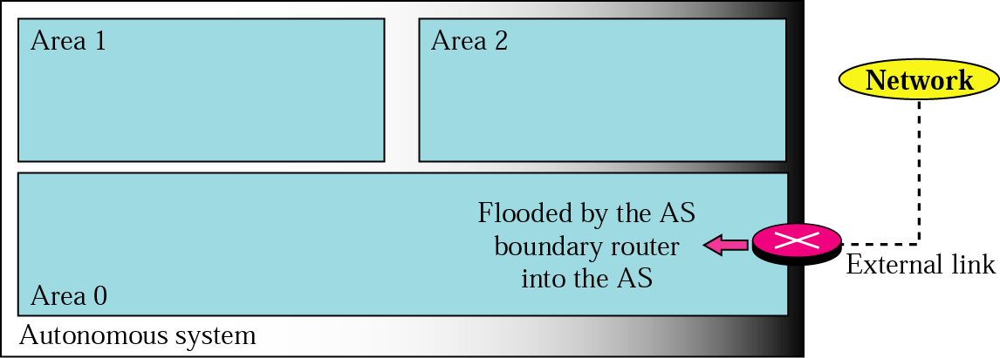
External link

Slide 26
Link State Database
Every router in an area receives the router link and network link LSAs from every other router and forms a link state database
Every router in the same area has the same link state database
Link state database – tabular representation of the topology of the internet inside an area – shows relationship between each router and its neighbours including the metrics

Slide 27
Note:
In OSPF, all routers have the same link state database.

Slide 28
Dijkstra Algorithm
To calculate routing table each router applies Dijkstra algorithm to its link state database
Dijkstra algorithm calculates the shortest path between two points on a network using a graph made up of nodes and edges
Algorithm divides the nodes into two sets: tentative and permanent. It chooses nodes, makes them tentative, examines them and if they pass the criteria, makes them permanent

Slide 29
Dijkstra Algorithm
1. Start with the local node (router): the root of the tree.
2. Assign a cost of 0 to this node and make it the first permanent node.
3. Examine each neighbor node of the node that was the last permanent node.
4. Assign a cumulative cost to each node and make it tentative.
5. Among the list of tentative nodes
1. Find the node with the smallest cumulative cost and make it permanent.
2. If a node can be reached from more than one direction
1. Select the direction with the shortest cumulative cost.
6. Repeat steps 3 to 5 until every node becomes permanent.

Slide 30
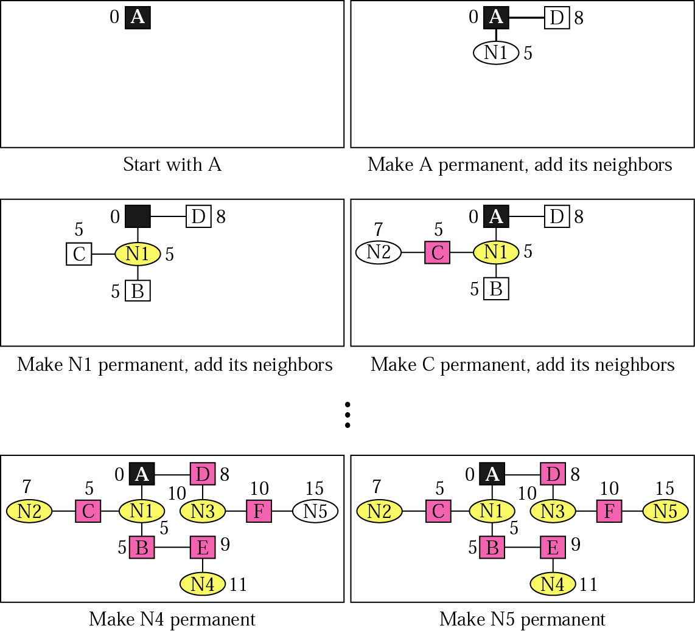
Shortest-path calculation

Slide 31
Routing Table
Each router uses the shortest-path tree method to construct its routing table
Routing table shows cost of reaching each network in the area
To find the cost of reaching networks outside of the area, routers use the summary link to network, the summary link to boundary router and the external link advertisements

Slide 32
Link state routing table for router A
Network | Cost | Next Router | Other Information
N1 | 5 | C
N2 | 7 | D
N3 | 10 | B
N4 | 11 | D
N5 | 15 | C

